Slide 1

Good morning

Slide 2
Last class
Bayes Rule
Distributions
MAP
MLE

Slide 3
Today’s class
Joint distributions
Naïve Bayes classifier
Bayes optimal classifier
Gibbs classifier
MDL principle

Slide 4
Joint distributions

Slide 5
Random Vector
Let us play a game
You toss a coin
I’ll Toss a dice
You win if H and odd number are outcomes
I win if T and Even number are outcomes.
Make them as a pair(Vector ) of rvs and get their joint distribution, to get our chances to win.
 |  | Toss a Die
Toss A Coin |  | 1 | 2 | 3 | 4 | 5 | 6
 | H | 1/12 | 1/12 | 1/12 | 1/12 | 1/12 | 1/12
 | T | 1/12 | 1/12 | 1/12 | 1/12 | 1/12 | 1/12

Slide 6
Another Example of Joint p.f.
Throw a die once, let X be the outcome. Throw a fair coin X times and let Y be the number of heads. Find P(x,y)?
Solution:
The possible X values range from 1 to 6.
The possible Y values range from 0 to 6.
When X = 2 (e.g.) Y = 0,1 or 2.
P(2,0) = P(X=2,Y=0) = P(X=2)P(Y=0|X=2)
=(1/6)(1/2)²=1/24.

Slide 7
Jointly Distributed Random Variables
Joint Probability Distributions
Discrete
Continuous

Slide 8
Jointly Distributed Random Variables
Joint Cumulative Distribution Function
Discrete
Continuous

Slide 9
Example-Joint Distribution
Air Conditioner Maintenance
A company that services air conditioner units in residences and office blocks is interested in how to schedule its technicians in the most efficient manner
The random variable X, taking the values 1,2,3 and 4, is the service time in hours
The random variable Y, taking the values 1,2 and 3, is the number of air conditioner units

Slide 10
Example-Joint Distribution
Y= number of units | X=service time
 | 1 | 2 | 3 | 4
1 | 0.12 | 0.08 | 0.07 | 0.05
2 | 0.08 | 0.15 | 0.21 | 0.13
3 | 0.01 | 0.01 | 0.02 | 0.07
Joint p.m.f
Joint cumulative distribution function

Slide 11
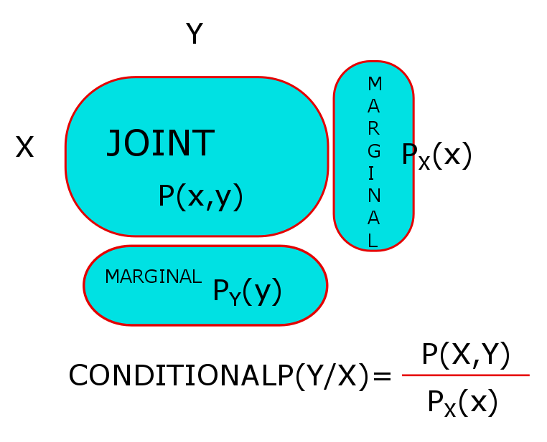
Bivariate
BIVARIATE DISCRETE

Slide 12
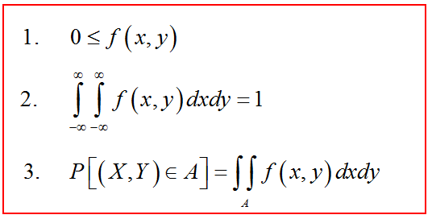
BIVARIATE CONTINUOUS RV’S
Definition: Two random variable are said to have joint probability density function f(x,y) if

Slide 13
Definition: Let X and Y denote two random variables with joint probability density function f(x,y) then
the marginal density of X is
the marginal density of Y is

Slide 14
Conditional density
Let X and Y denote two random variables with joint probability density function f(x,y) and marginal densities f_{X}(x), f_{Y}(y) then
the conditional density of Y given X = x
conditional density of X given Y = y

Slide 15
Let
where
This distribution is called the bivariate Normal distribution.
The parameters are μ₁, μ₂ , σ₁, σ₂ and ρ.

Slide 16
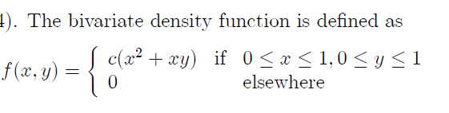
Bivariate-Example
If X and Y are jointly distributed as given by
Find c and their marginal pdf’s

Slide 17


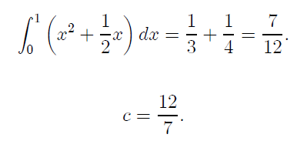
Bivariate-Example

Slide 18

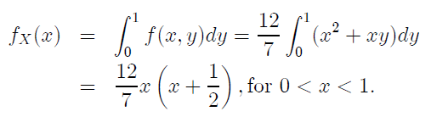
Bivariate-Example
Recall that

Slide 19
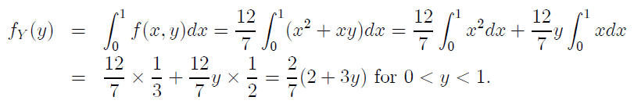
Bivariate-Example
Similarly, the pdf of Y is

Slide 20
Good morning

Slide 21
Naïve Bayes classifier
Naïve Bayes makes a naïve assumption that the events are independent to ease computation and get an answer, knowing well that they may not be independent practically.

Slide 22
Naïve Bayes classifier
Classification-Assigning an input to one of the classes which has the maximum Bayes’ posterior probability.
The class Ci for which P(Ci/X) is maximized is called the maximum posteriori hypothesis.
P(Ci/X) =P(X/Ci)P(Ci)/P(X)

Slide 23
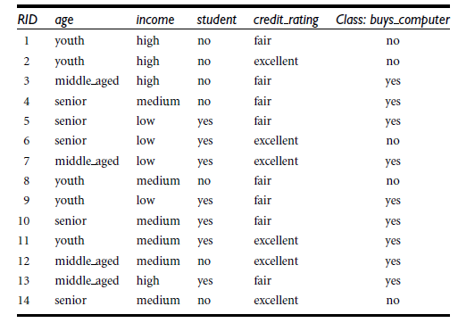
Naïve Bayes classifier
Consider an example

Slide 24
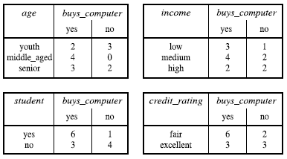
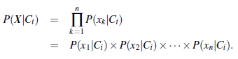
Naïve Baye’s Classifier Example
The attribute wise data is ,

Slide 25
Naïve Baye’s Classifier Example
X = (age = youth, income = medium, student = yes, credit rating = fair)
We need to maximize P(X/Ci)P(Ci), for i = 1, 2. P(Ci), the prior probability of each
class, can be computed based on the training tuples:
P(buys computer = yes) = 9/14 = 0.643
P(buys computer = no) = 5/14 = 0.357

Slide 26
Naïve Baye’s Classifier Example
X = (age = youth, income = medium, student = yes, credit rating = fair)
To compute P(X/Ci), for i = 1, 2, we compute the following conditional probabilities:
P(age = youth / buys computer = yes) = 2/9 = 0.222
P(age = youth / buys computer = no) = 3/5 = 0.600
P(income = medium / buys computer = yes) = 4/9 = 0.444
P(income = medium /buys computer = no) = 2/5 = 0.400
P(student = yes / buys computer = yes) = 6/9 = 0.667
P(student = yes / buys computer = no) = 1/5 = 0.200
P(credit rating = fair / buys computer = yes) = 6/9 = 0.667
P(credit rating = fair / buys computer = no) = 2/5 = 0.400

Slide 27
Naïve Baye’s Classifier Example
Using the above probabilities, we obtain
P(X/buys computer = yes) =
P(age = youth / buys computer = yes) *
P(income = medium / buys computer = yes)*
P(student = yes / buys computer = yes) *
P(credit rating = fair / buys computer = yes)
= 0.222*0.444*0.667*0.667 = 0.044.
Similarly,
P(X/buys computer = no) = 0.600*0.400*0.200*0.400 = 0.019.

Slide 28
Naïve Baye’s Classifier Example
To find the class, Ci, that maximizes P(X/Ci)P(Ci), we compute
P(X/buys computer = yes)P(buys computer = yes) = 0.044*0.643 = 0.028
P(X/buys computer = no)P(buys computer = no)
=0.019*0.357 = 0.007
Therefore, the naïve Bayesian classifier predicts buys computer = yes for tuple X.

Slide 29
Naïve Baye’s Classifier Text classification
Attributes are text positions, values are words.

Slide 30
Naïve Baye’s Classifier Text classification
From training corpus, extract Vocabulary
Calculate required P(c_{j}) and P(x_{k} | c_{j}) terms
For each c_{j} in C do
docs_{j} ← subset of documents for which the target class is c_{j}
Text_{j} ← single document containing all docs_{j}
for each word x_{k} in Vocabulary
n_{k} ← number of occurrences of x_{k} in Text_{j}

Slide 31
 | Doc | Words | Class
Training | 1 | Chinese Beijing Chinese | c
 | 2 | Chinese Chinese Shanghai | c
 | 3 | Chinese Macao | c
 | 4 | Tokyo Japan Chinese | j
Test | 5 | Chinese Chinese Chinese Tokyo Japan | ?
Priors:
P(c)=
P(j)=
3
4
1
Choosing a class:
P(c|d5)
P(j|d5)
4
3/4 * (3/7)³ * 1/14 * 1/14
≈ 0.0003
Conditional Probabilities:
P(Chinese|c) =
P(Tokyo|c) =
P(Japan|c) =
P(Chinese|j) =
P(Tokyo|j) =
P(Japan|j) =
(5+1) / (8+6) = 6/14 = 3/7
(0+1) / (8+6) = 1/14
1/4 * (2/9)³ * 2/9 * 2/9
≈ 0.0001
(0+1) / (8+6) = 1/14
(1+1) / (3+6) = 2/9
(1+1) / (3+6) = 2/9
(1+1) / (3+6) = 2/9

Slide 32
Good morning

Slide 33
Bayes Optimal classifier
MAP ,ML, Bayes.. discuss the most probable or representative for the data. But that is to get the model ready. Its purpose , like classification, needs the models efficiency on any new instance and the most probable classification need not be the most likely one or MAP.
consider a hypothesis space containing three hypotheses, hl, h2, and h3 with posteriors 0.4,0.3 and 0.3 resply. The MAP is h1. Suppose a new instance x1 is classified positive by h1 and negative by h2 and h3, then the most likely classification is negative (h2+h3)

Slide 34
Bayes Optimal classifier
Hence, the most probable classification of the new instance is obtained by combining the predictions of all hypotheses, weighted by their posterior probabilities.
If the possible classification of the new example can take on any value vj from some set V, then the probability P(vjlD) that the correct classification for the new instance is vj, is
The optimal classification of the new instance is the value vj, for which P (vj | D) is maximum.

Slide 35
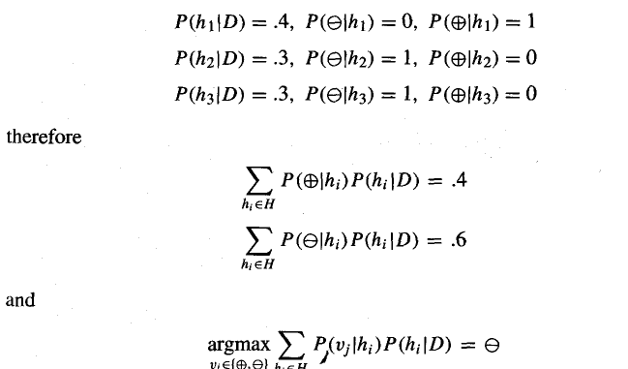
Bayes Optimal classifier
So, for the previous discussion,

Slide 36
Gibbs Algorithm
1. Choose a hypothesis h from H at random, according to the posterior probability distribution over H.
2. Use h to predict the classification of the next instance x.

Slide 37
Good morning

Slide 38
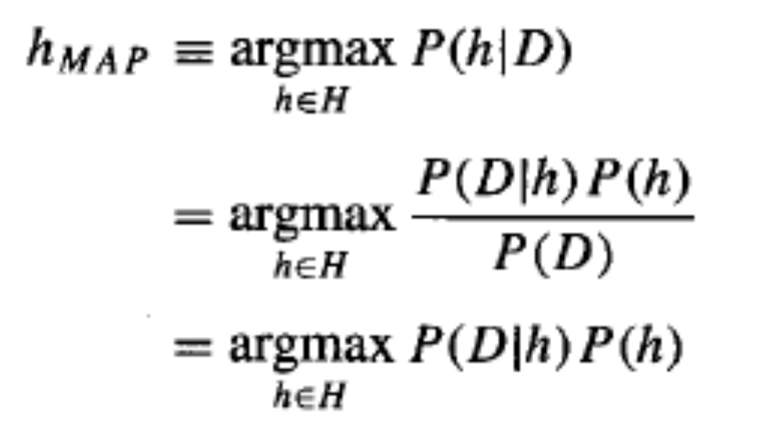


Minimum Description length Principle
From MAP
- log, P(h) is the description length of h under the optimal encoding for the hypothesis space H.
-log2 P(D1h) is the description length of the training data D given hypothesis h, under its optimal encoding.

Slide 39

Minimum Description length Principle
From MAP
Shannon –
the optimal code (i.e., the code that minimizes the expected message length) assigns - log, pi bitst to encode message i .
minimize the expected code length we should assign shorter codes to messages that are more probable.
number of bits required to encode message i using code C as the description length of message i with respect to C, which we denote by Lc(i)

Slide 40
Good morning

